Slide 1




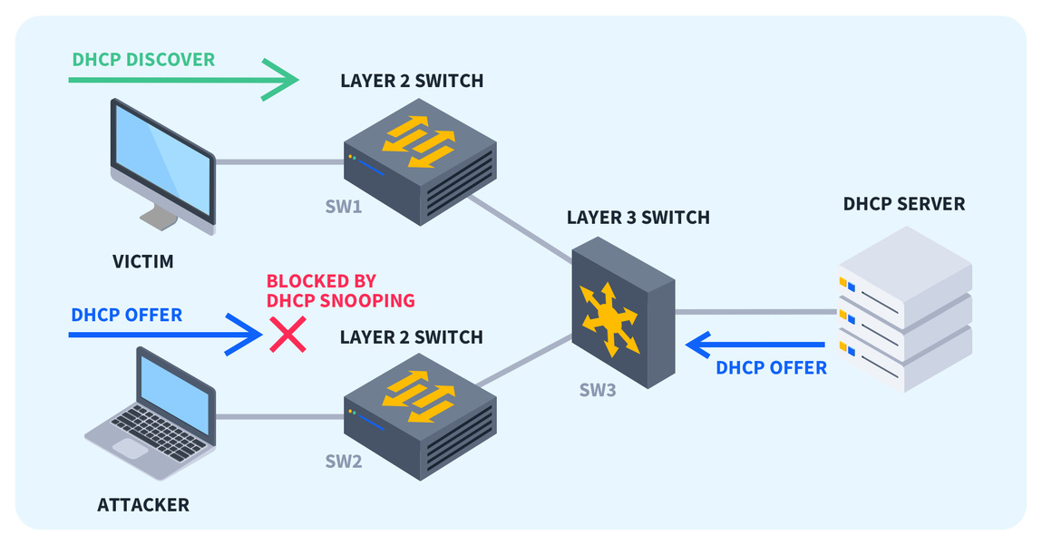
CyberSecurity Project (Group-3)
DHCP Starvation and
Rogue DHCP Server Attack
Team Members -
Om Sharma
Mayank Dahiya
Anmol Yadav
Meet Tilala
Rudra Gupta

Slide 2
